Slide 1
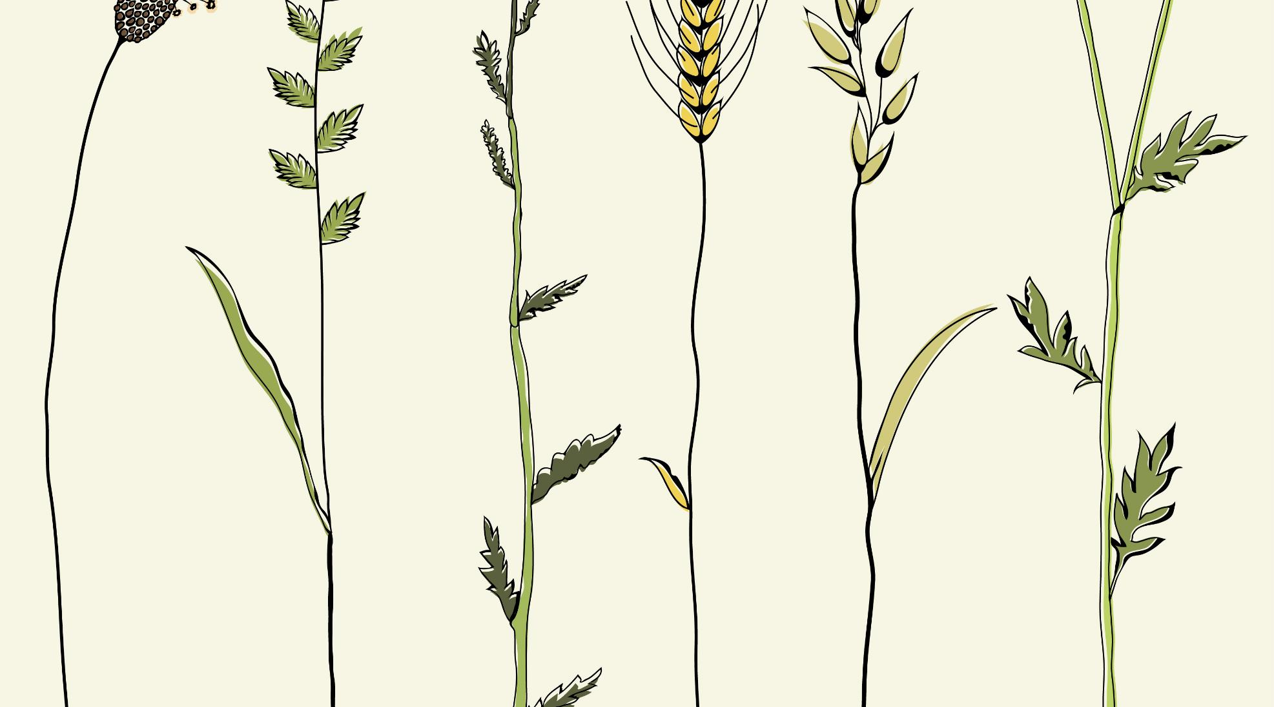
Precision Agriculture – Coimbatore based crop suggestion system using ML and IoT
TEAM 9
Gayathri B – 18Z218
Poovizhi Mangai S K – 18Z236
Praja S S – 18Z237
Shivathmica C – 18Z249
Sneha Sridharan – 18Z252
Guide Name: Dr. N. Gopika Rani, Assistant Professor (Selection Grade)
Company Name: Niagara Automations, Coimbatore

Slide 2
AGENDA
Abstract
Problem Definition
Literature Survey
System Design
Implementation
Result Analysis
Conclusion
References
Existing vs Proposed System

Slide 3
ABSTRACT
A crop recommendation system has been developed, with an intention to assist the farmers in the Coimbatore district of Tamil Nadu in helping them select appropriate crops based on the soil in their farms.
A system to recommend the most appropriate crop to farmers using machine learning models such as Random forest, KNN and Decision tree which are combined to form an ensemble model.
It is based on input parameters like soil pH, EC (Electrical Conductivity), N, P, K, soil type, and environmental conditions like temperature and rainfall.
The trained model is further given real time inputs from the IoT system along with user inputs to give the output.

Slide 4
PROBLEM DEFINITION
Coimbatore is the second largest city in the state of Tamil Nadu which is situated on the banks of the Noyyal River and surrounded by the Western Ghats.
The cultivable soil of the district is classified into 16 different soil series having different soil properties. All sorts of traditional farming practices exist here.
Farmers of Coimbatore are unaware of the heterogeneous nature of soil. There are differences in soil properties occurring even within short distances.
Growing the same crop as the neighbouring farmer will not be as profitable as it is for them.
Also, choosing a crop for cultivation based only on market trends will cause adverse loss financially and worsen the quality of soil.
This automated crop suggestion system alleviates farmers from the pitfalls of traditional farming practices and paves way for better agricultural profit and productivity. Furthermore, it proves to give the best accuracy and present the most accurate result.

Slide 5
LITERATURE SURVEY
Paper name | Methodology used | Advantages | Disadvantages
AgroConsultant: Intelligent Crop Recommendation System Using Machine Learning Algorithms Zeel Doshi, Rashi Agrawal, Subhash Nadkarni, Prof. Neepa Shah | Decision Tree (90.2%) K Nearest Neighbor (K-NN) (88.78%) Random Forest (90.43%) Neural Network (91%) | Compared various algorithms and chose the best one. Accuracy of the model is very high. | Absence of sensors for input making it essential for users to type all the inputs. Multiple models are not used together.
Machine learning approach: Recommendation of suitable crop for land using meteorological factors Srilakshmi A, Madhumitha K, Geetha K | Random forest, decision tree and SVM | Ample number of datasets are collected for training and testing for better accuracy. Aimed at deciding which model has highest accuracy: Random forest -95.09%. | Less soil parameters are considered. Only static data is provided to the trained model.

Slide 6
Paper name | Methodology used | Advantages | Disadvantages
Recommendation System for ​ Crop Identification and Pest Control Technique in ​ Agriculture​ Avinash Kumar, Sobhangi, Chittaranjan Pradhan​ ​ | SVM Classification (89.66%)​ Decision Tree (86.80%)​ Logistic Regression (86.04%)​ | All major parameters are included for recommendation system.​ Used different algorithms to choose the one with highest accuracy.​ Apart from identification, Pest control techniques is also suggested.​ ​ | Since the user manually input the values, he may be unaware of the exact values which might mislead.​
Recommendation System Using Neural Networks Tanmay Banavlikar, Aqsa Mahir, Mayuresh Budukh, Soham Dhodapkar | Artificial Neural Networks IoT | The input data are collected using sensors to get the accurate value which gives the correct recommendation. | Few more parameters could be taken into account for more effective recommendation.

Slide 7
Paper name | Methodology used | Advantages | Disadvantages
Crop Recommendation System for Precision Agriculture S.Pudumalar, E.Ramanujam, R.Harine Rajashree, C.Kavya, T.Kiruthika, J.Nisha | Ensemble Model (Voting Based classifier) Random tree, CHAID, K-Nearest Neighbor and Naive Bayes (88%) | Combined the power of multiple models. Use of varying soil parameters. | Environmental parameters are not used in this model.

Slide 8
EXISTING vs PROPOSED SYSTEM
METHODOLOGY USED
One existing system used majority voting technique with learners such as Random forest, Decision tree and SVM.
Another existing system used ANN
DRAWBACKS
Absence of sensors for input making it essential for users to type all the inputs.
METHODOLOGY USED
Ensemble model with majority voting technique, using a combination of algorithm namely Random Forest, kNN, and Decision Tree.
Arduino Uno embedded with Temperature sensor and pH sensor to input accurate values of the above parameters to the system.
ADVANTAGES
Designed exclusively for areas in and around Coimbatore.
Since IoT is implemented to collect input data, the recommendation system is very precise and suitable.

Slide 9
SYSTEM DESIGN
Sensor Data (IoT)
User Input (Location, Soil type)
Environment Data
Random Forest
Decision Tree
KNN
Trained Model
Recommended crop
Data Pre-processing like treating missing values and outliers
Feature Scaling
Ensemble Model
Soil Characteristics

Slide 10
Arduino Uno R3 and Sensors
Arduino IDE
Input to the trained system

Slide 11
IMPLEMENTATION
https://drive.google.com/file/d/1i-9pd_JrwiwZtvwOPFvglWSnN5fCocbi/view?usp=sharing

Slide 12
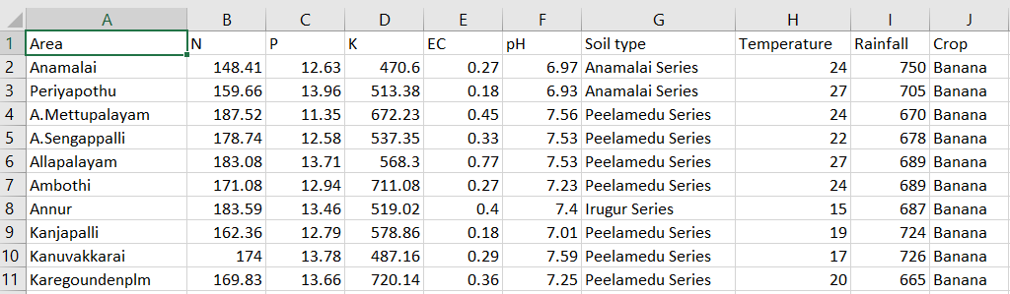
DATA SET

Slide 13
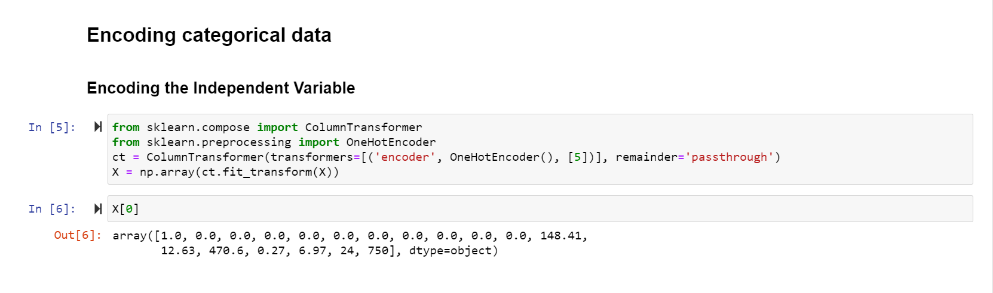
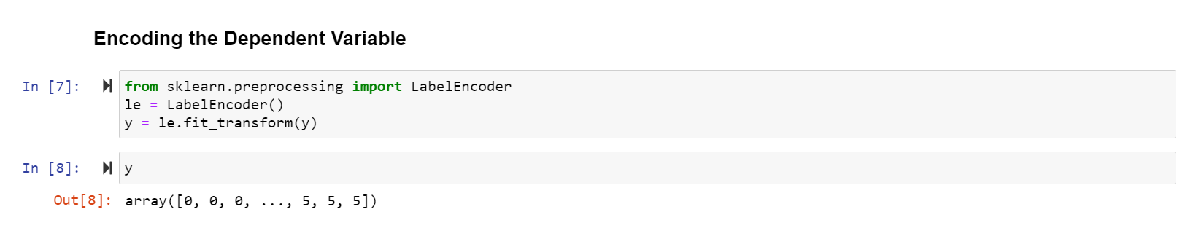

Slide 14
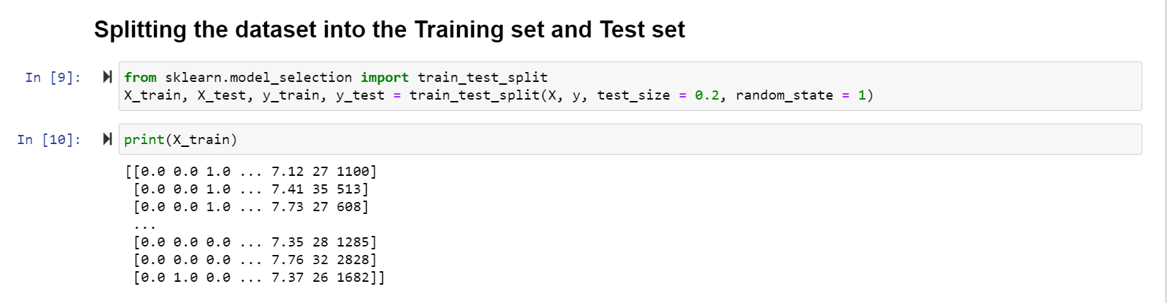
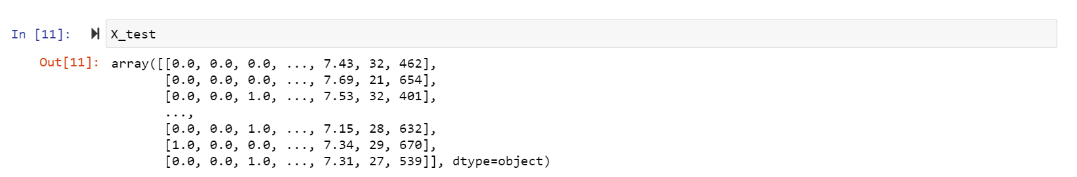

Slide 15
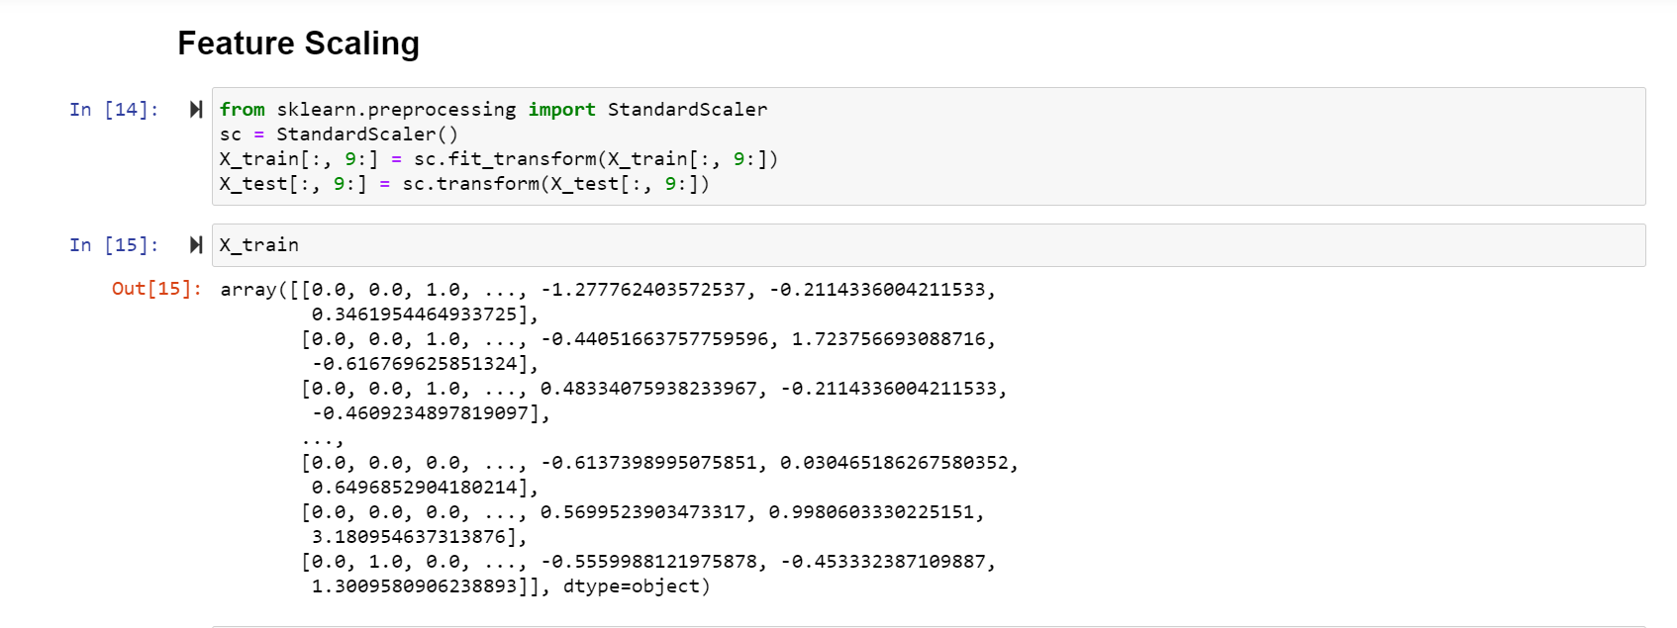
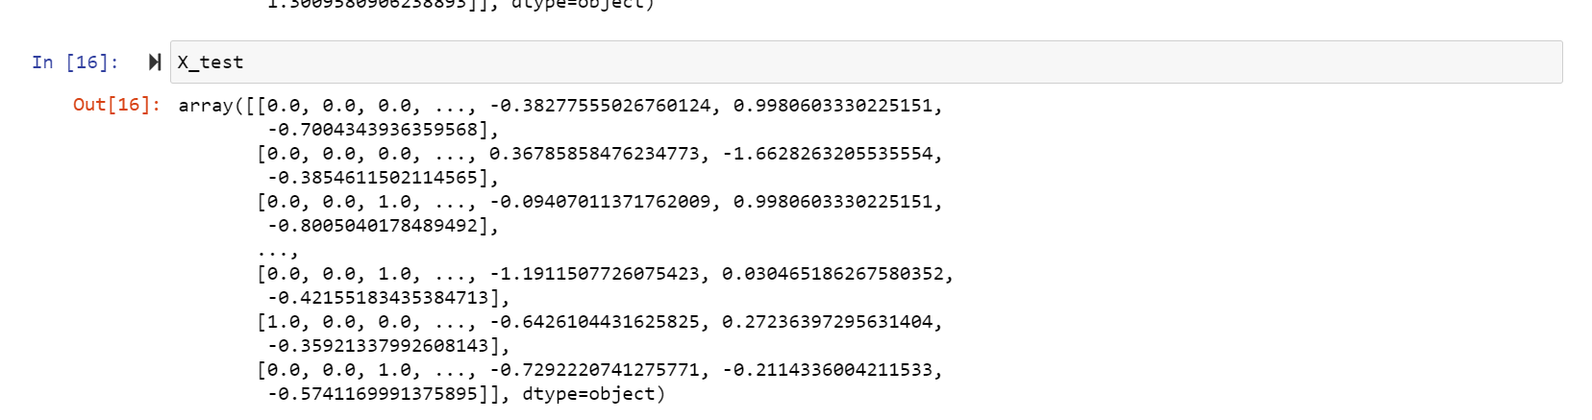

Slide 16
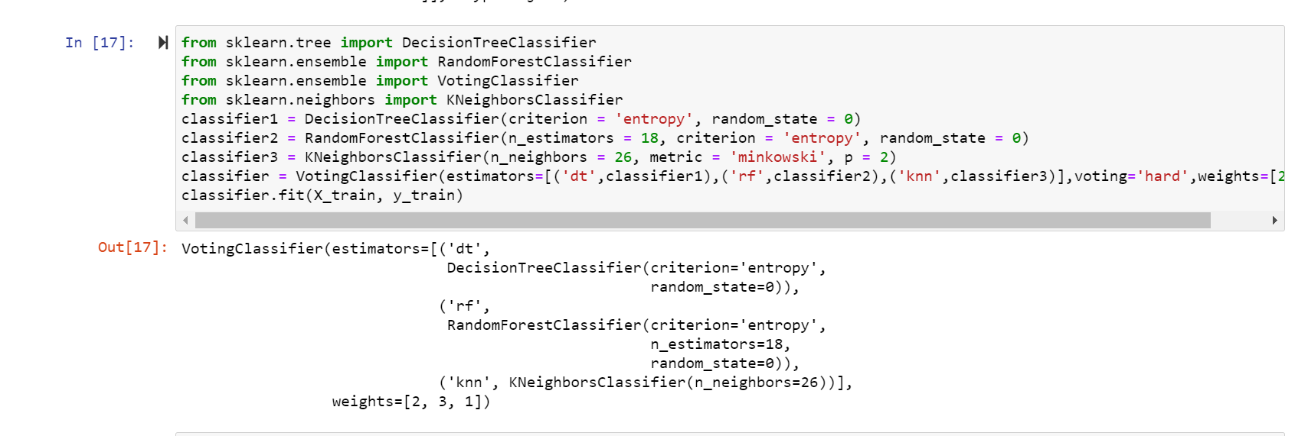
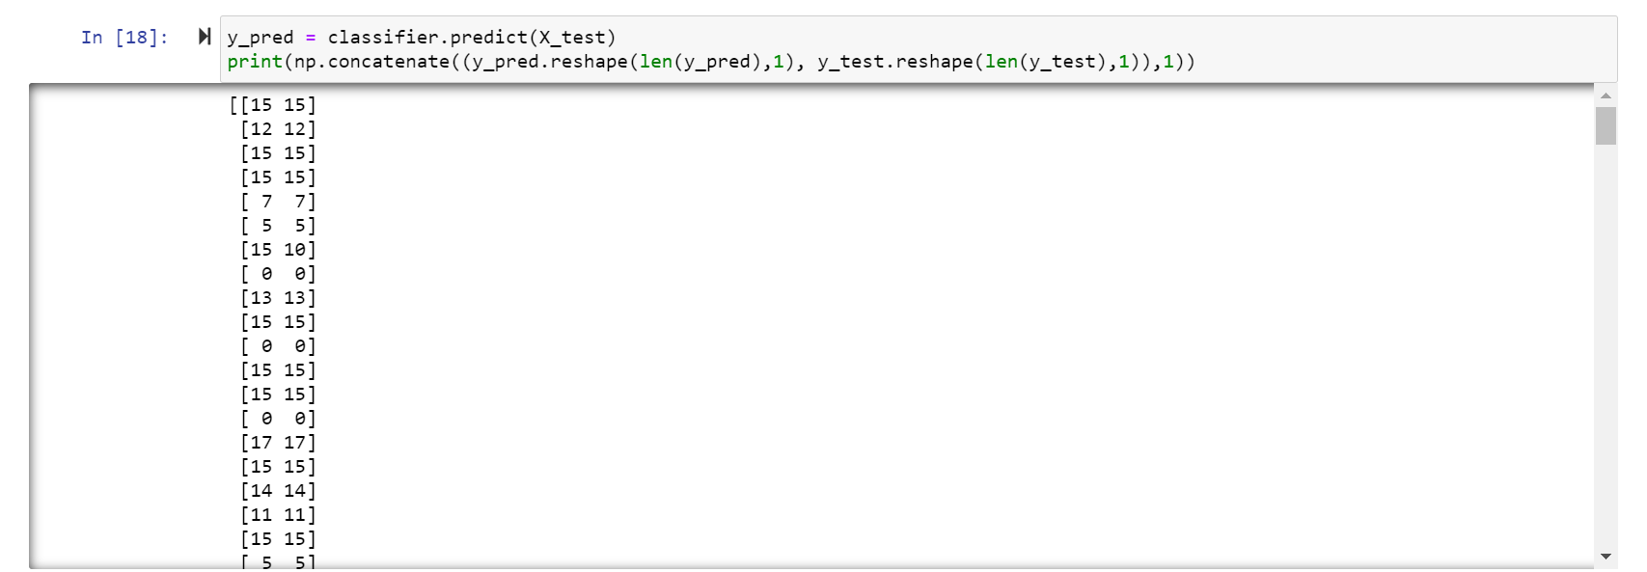

Slide 17
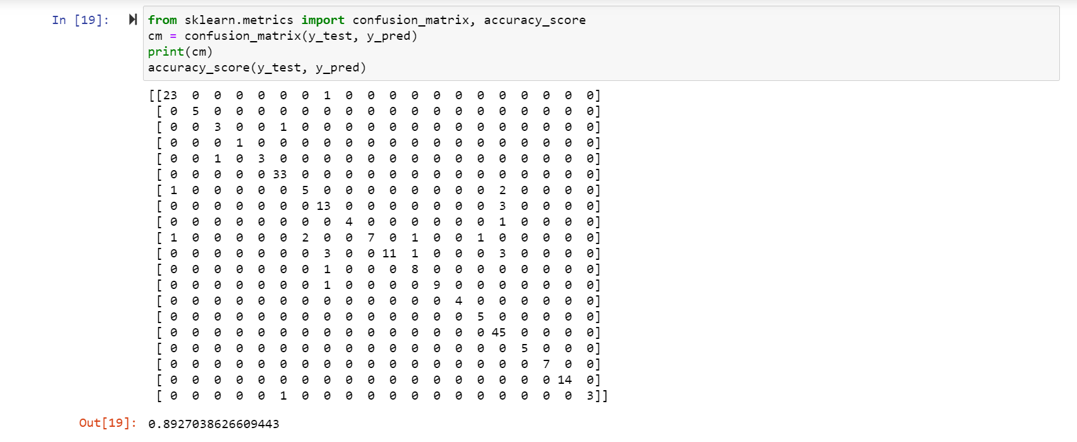

Slide 18
CIRCUIT CONNECTIONS

Slide 19
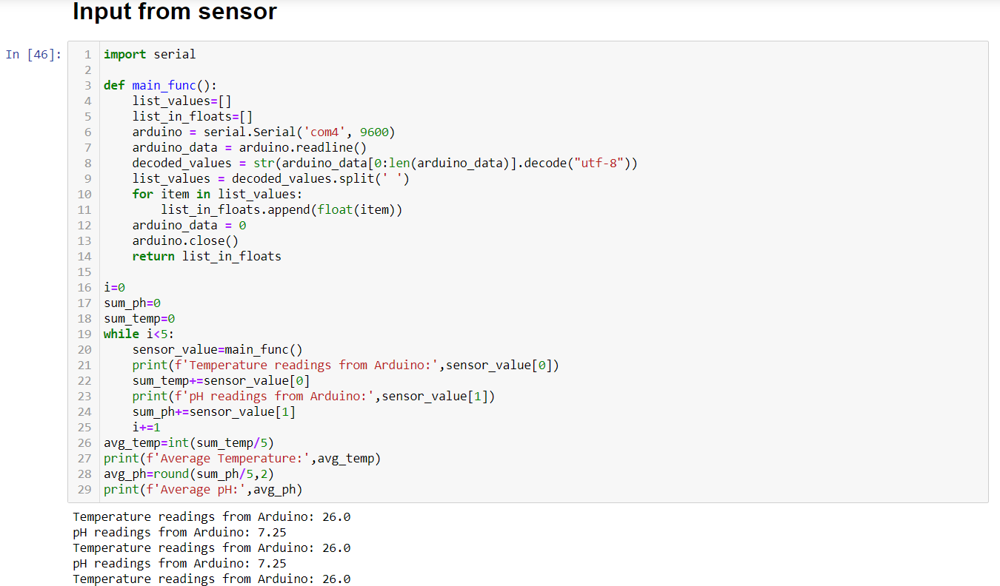

Slide 20
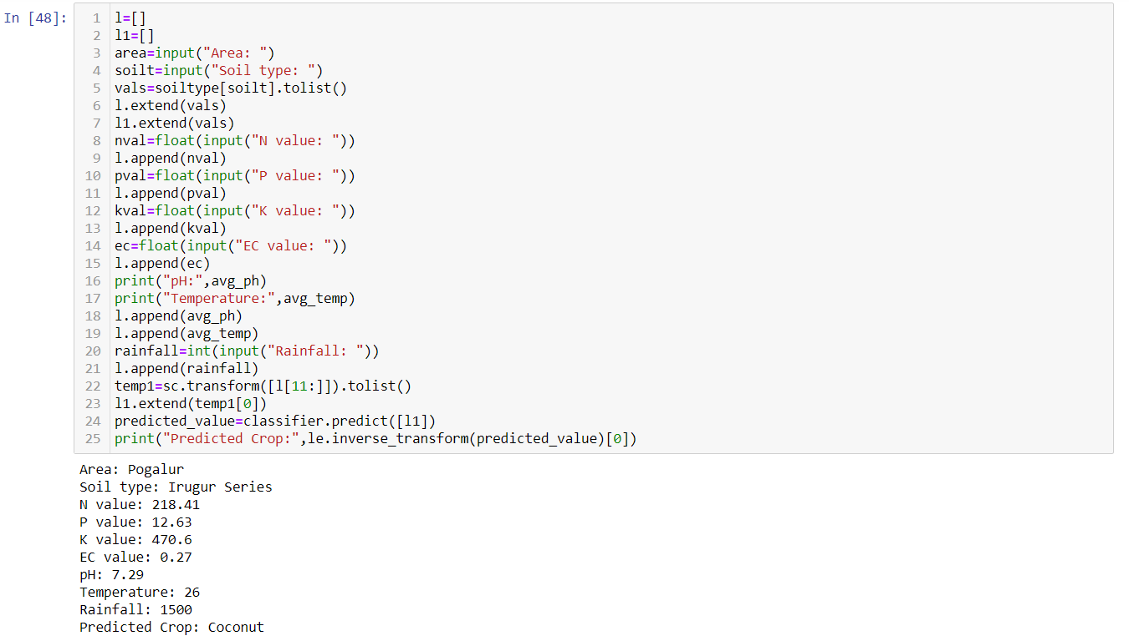

Slide 21
RESULT ANALYSIS

Slide 22
COMPARISON
EXISTING SYSTEM
PROPOSED SYSTEM
One existing system used majority voting technique with learners such as Random forest, Decision tree and SVM with accuracy 84.54%.
Another existing system used ANN with accuracy 76.1%.
Ensemble model with majority voting technique, using a combination of algorithm namely Random Forest, kNN, and Decision Tree with accuracy 89.27%.

Slide 23
CONCLUSION
The proposed system plays a major role in assisting the farmers to make a decision on the best crop to be grown on their farm land located in Coimbatore. This system considers various soil and environmental factors, and IoT sensor values to predict the accurate crop. The ensemble learning model used provides an advantage by combining the accuracies of KNN, random forest and decision tree algorithms and gives a resulting accuracy of 89.27%.
FUTURE ENHANCEMENTS
As an enhancement of the proposed system, additional IoT sensors for other parameters can be used. Also, crop rotation can be included as a new feature to predict the crop based on the previously grown crop.

Slide 24
REFERENCES
Z. Doshi, S. Nadkarni, R. Agrawal and N. Shah, "AgroConsultant: Intelligent Crop Recommendation System Using Machine Learning Algorithms," 2018 Fourth International Conference on Computing Communication Control and Automation (ICCUBEA), Pune, India, 2018, pp. 1-6. doi: 10.1109/ICCUBEA.2018.8697349
Srilakshmi A, Madhumitha K, Geetha K, "Machine learning approach: Recommendation of suitable crop for land using meteorological factors", Proceedings of the 2nd International Conference on IoT, Social, Mobile, Analytics & Cloud in Computational Vision & Bio-Engineering (ISMAC-CVB 2020)
Avinash Kumar, Sobhangi Sarkar and Chittaranjan Pradhan, “Recommendation System for Crop Identification and Pest Control Technique in Agriculture”, International Conference on Communication and Signal Processing, April 4-6, 2019, India.
Tanmay Banavlikar, Aqsa Mahir, Mayuresh Budukh, Soham Dhodapkar, "Recommendation System Using Neural Networks", International Research Journal of Engineering and Technology(IRJET) Volume: 05 Issue: 05
S. Pudumalar, E. Ramanujam, R. H. Rajashree, C. Kavya, T. Kiruthika and J. Nisha, "Crop recommendation system for precision agriculture," 2016 Eighth International Conference on Advanced Computing (ICoAC), Chennai, 2017, pp. 32-36. doi: 10.1109/ICoAC.2017.7951740.

Slide 25
THANK YOU

